Slide 1
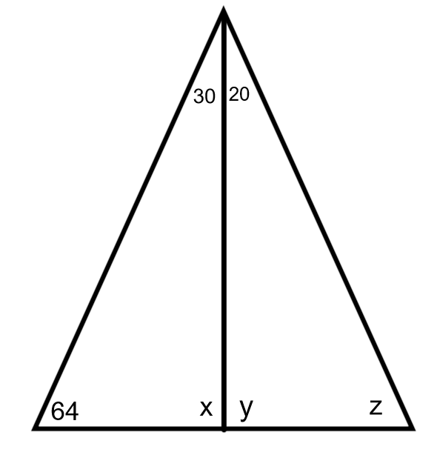
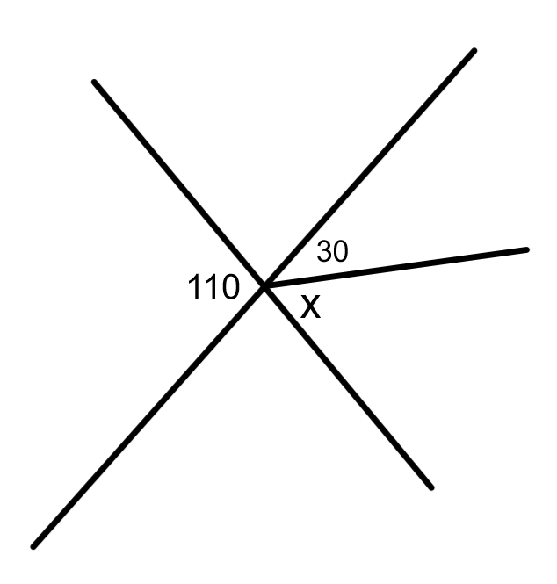
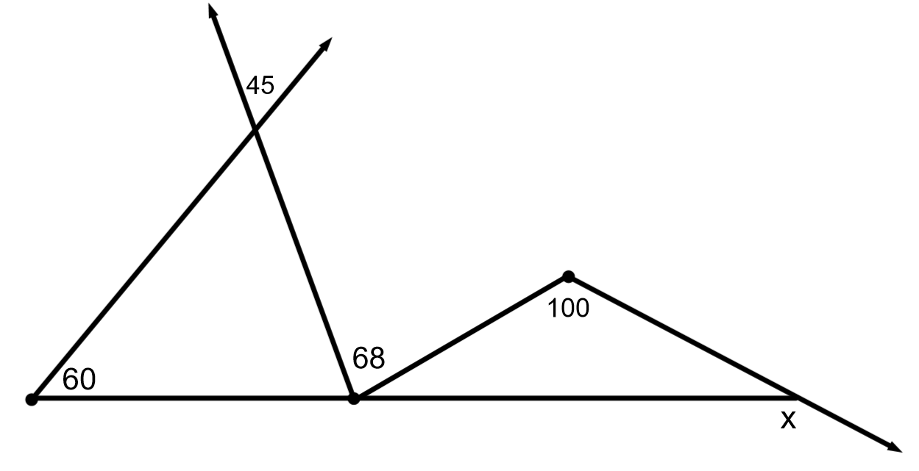
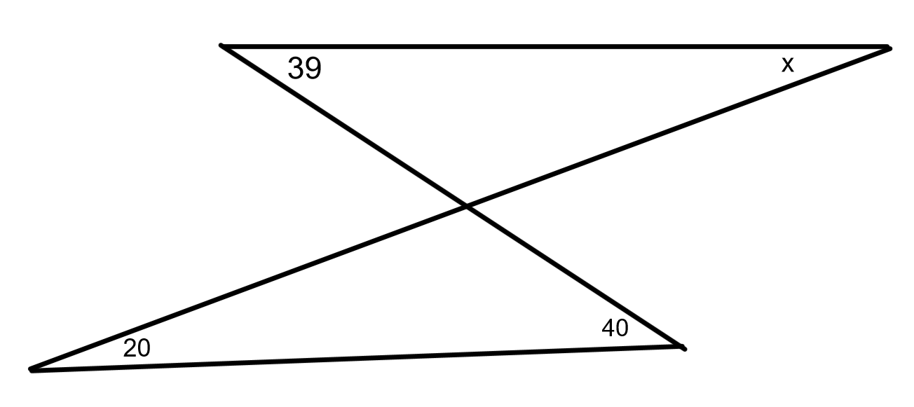
August 20th
Agenda:
Warm up
Homework Review and File
3. Triangle Sum and Exterior Angle Around the Desk
Isosceles triangle INB
Types of Triangles INB
Practice
Closer: Copy the theorems into notebook

Slide 2
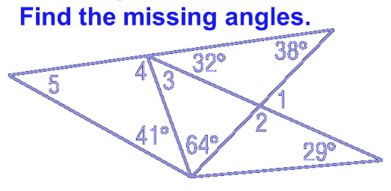
August 21st
Agenda:
O - Warm up
HW check and file
L - INB parallel lines
Parallel lines Maze
C – Parallel Lines McD’s Task

Slide 3
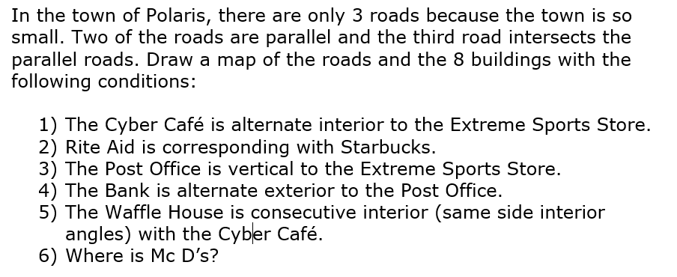
August 22nd
DON’T SIT!!! Use your Whiteboard!
#ThrowbackThursday Warm up
Agenda
Warm up
INB on Midsegments and Proportionality
Practice
Quiz Tmrw

Slide 4
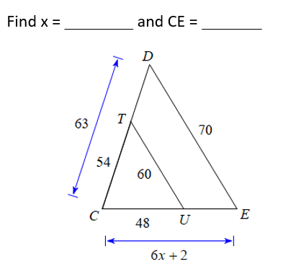
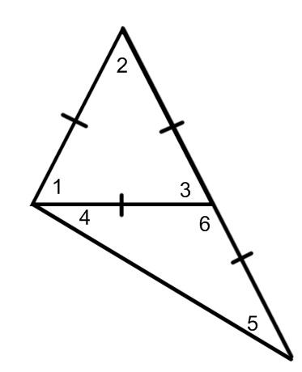
Warmup-- #MostMissedMonday
Hint: Try drawing the triangles separately
The following questions were missed the most on the quiz. Get with someone and work together at a whiteboard to figure out how we can solve these.
Hint: One angle must be ‘x’ so you must create an expression for the second angle
Find ALL angle measures. HINT: what do the markings tell us?
Two angles are complementary. The measure of one angle is 3 more than twice the measure of its complement. What is the measure of the two angles?

Slide 5
#TryItTuesday
Go to a whiteboard
We will be going through practice problems similar to last week’s quiz and you will determine what theorem will be used and then you will need to solve for the missing piece (use smartboard file)

Slide 6
#WhatCanYouDoWednesday
NO Warmup Today
You will complete the “Partner Quiz” with the person next to you. Discuss the problems together and make sure you understand how to solve with similar triangles and understand how to prove similar triangles.
After the “partner Quiz”, you will each complete a portion on your own to show what you can do
Homework: Quiz Corrections are due TOMORROW & complete the worksheet that is folded like a booklet ‘Practice-Similar Triangles’
Tutoring will be offered at 7:30 tomorrow in room 1205

Slide 7
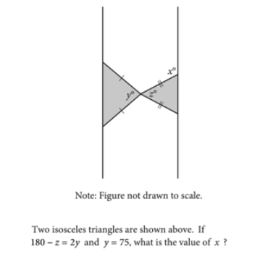
Aug 29th SAT practice Problem ☺

Slide 8
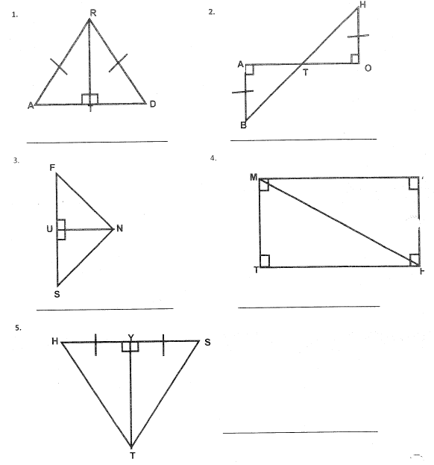
August 30th

Slide 9
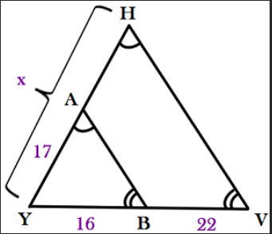
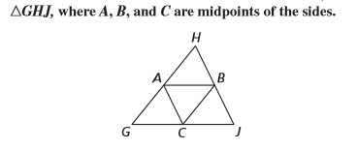
Aug. 3rd 1. Solve for x 2.

Slide 10
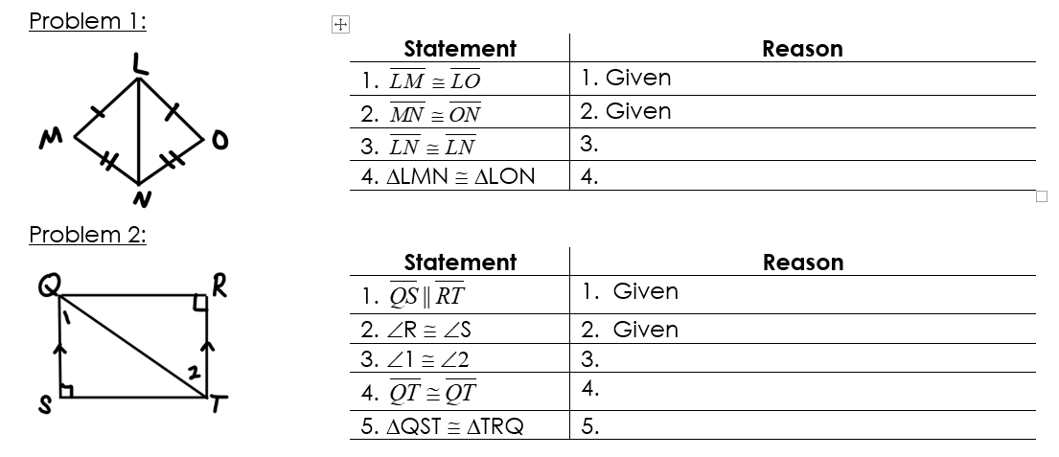

Slide 11
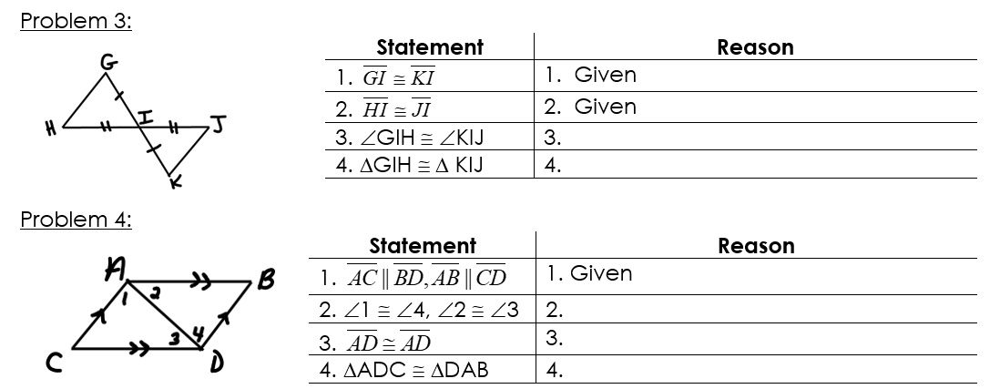

Slide 12
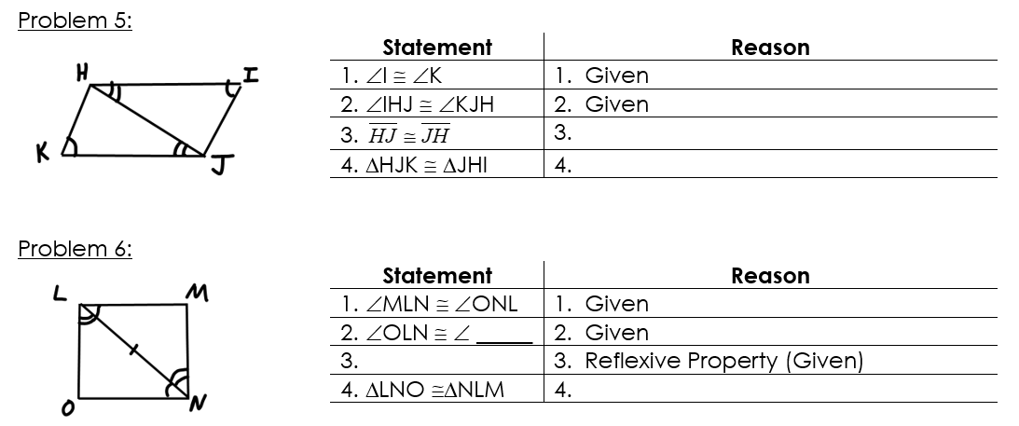

Slide 13
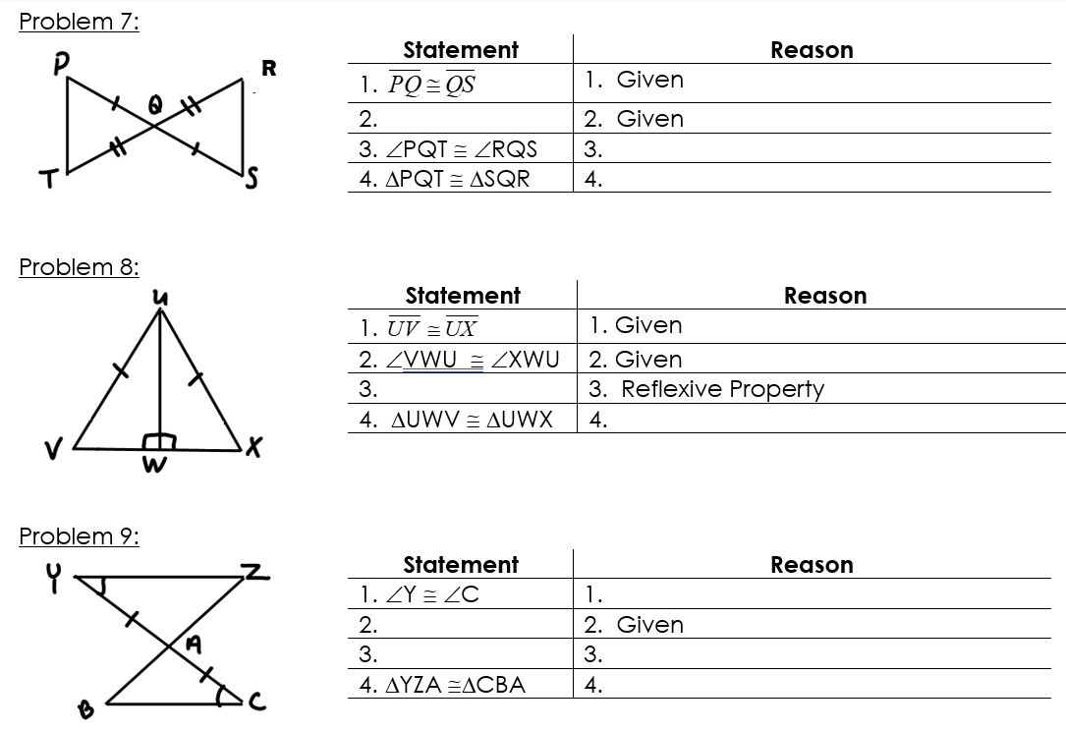

Slide 14
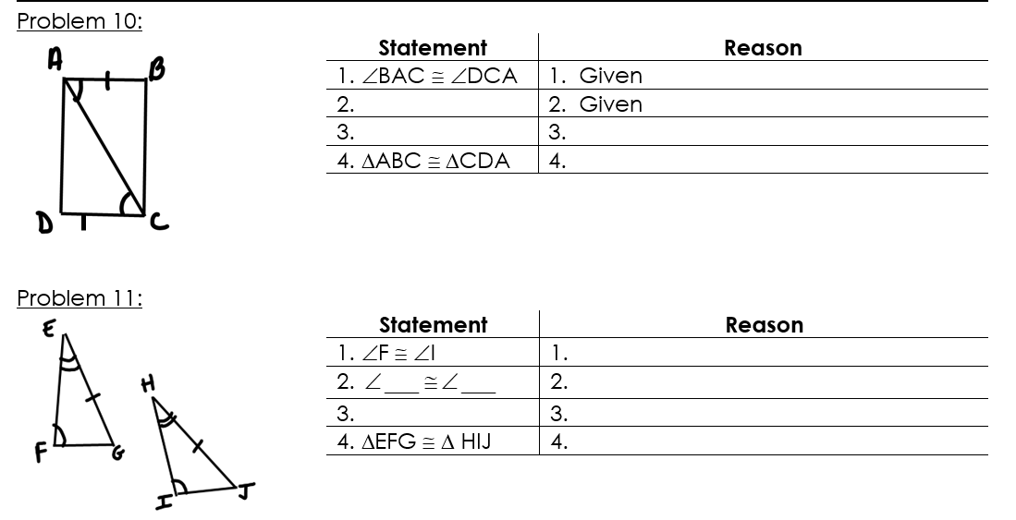

Slide 15
